Slide 1
Crime against real estate
Presented by:
Aggarwal paul
Alimetov Nadia
Martinez david

Slide 2

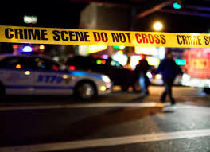
We were interested to determine if a relationship exist between crime rates and real estate in New York City:
Which borough has the costliest real estate?
Which borough has a high rate of crime relative to the others?
Has any borough seen a decrease in crime?

Slide 3
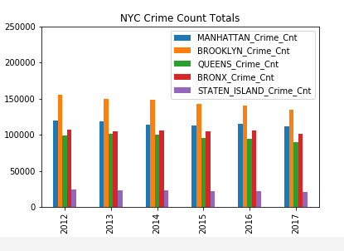
NYC Crime rates per borough (2012-2017)
Brooklyn
Manhattan
Bronx
Queens
Staten Island

Slide 4
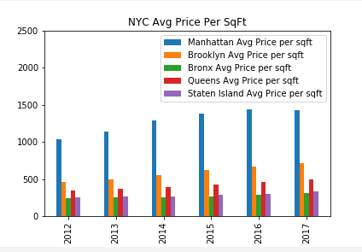
Average real estate prices per Sq ft
Manhattan
Brooklyn
Queens
Staten Island
Bronx

Slide 5
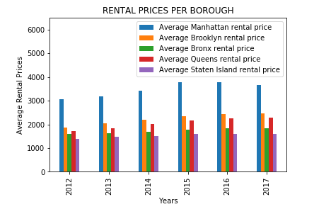
Average rental prices
Manhattan
Brooklyn
Queens
Staten Island
Bronx

Slide 6
New skills:
challenges:
Cleaning data
Graphic outputs
Researching metadata
New functions

Slide 7
Conclusion:
6-8 bullet points

